Slide 1

Predicting Tesla Stock Prices from Elon Musk’s Tweets
Yunhong Yang, Yu Tao, Nianqing Chen, Xiaodan Lu

Slide 2
Table of Contents
01
02
03
Introduction
Data Overview
Sentiment Analysis
04
05
06
Modeling
Conclusions
Future Work

Slide 3
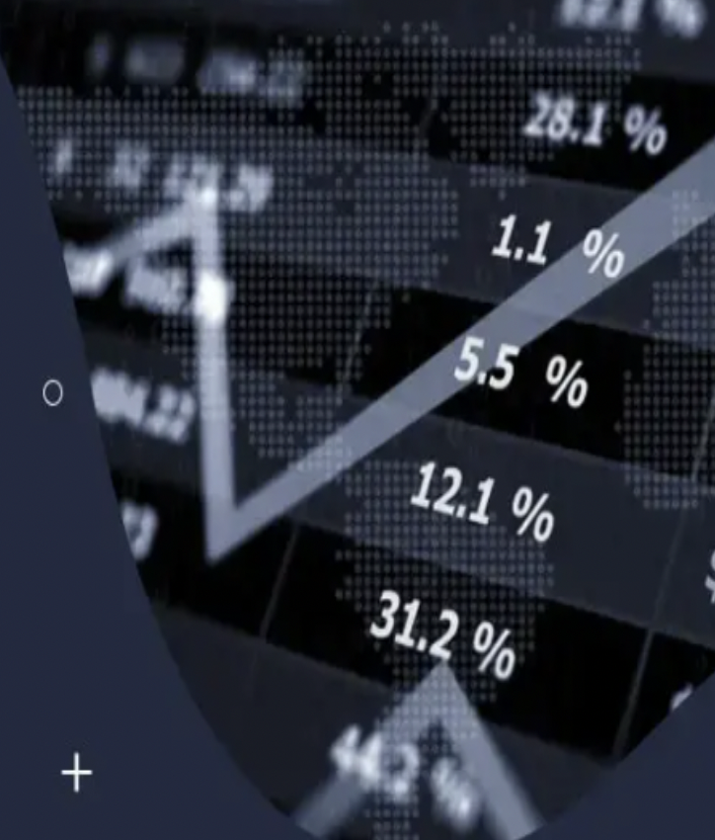
Introduction
Analyzing and predicting stock trends has always been an important topic in the financial market.
In the age of social media, the Internet has become the main platform for people to express their opinions and ideas.
In such an environment, it is worth exploring whether the public statements of corporate executives will affect the share price of the company.
Notes:
Predicting stock movements has always been an important topic in the financial market, as most investors base their investment strategies on changes in stock prices. Meanwhile, in the age of social media, the Internet has become the main platform for people to express their opinions and ideas. Online public opinion now plays an important role in the process of public events. Therefore, in such an environment, it is worth exploring whether the public statements of corporate executives affect the company's stock price.

Slide 4


Goals & Objectives
Use Tesla Inc. and Tesla's angel investor and CEO Elon Musk to examine whether there is a correlation between Elon Musk's tweets and the volatility of Tesla's stock price.
Goal: To predict the movement of Tesla's stock price by Musk's tweets.
Notes:
So let's take the example of Elon Musk, who is the CEO of Tesla and who is also active on Twitter, and also his company, Tesla, a company that sells electric cars and energy production. We want to check if there is a correlation between Elon Musk's tweets and Tesla's share price. If there is, investors can develop better investment strategies because they can use the tweets to predict the share price, especially of Tesla Inc.

Slide 5
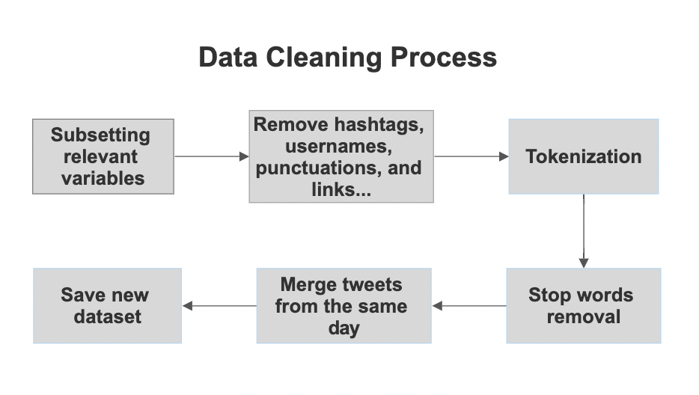
Data
The first raw dataset is the tweets of Elon Musk from 2010 to 2021 from the Kaggle website. It has a total of 12,562 tweets.
After cleaning, it has 2,033 tweets.
The second raw dataset is daily stock prices of Tesla company collected from Yahoo Finance.
The date is from 2011-12-01 to 2021-04-17.
Notes:
To achieve this, we found our first dataset from the Kaggle website, which is about Elon Musk's tweets from 2010 to 2021. We cleaned it and the flowchart shows the main process of cleaning, like we subset the data and remove links, hashtags, and stop words. The most important step we would like to mention is the merging of tweets from the same day, since Elon Musk sometimes tweets several times a day. Therefore, we combine them for the sake of understanding and analysis. Another point we should mention is that there was only one tweet in 2010 and in the end we decided to delete it and focus on analyzing tweets from 2011 to 2021 because there was enough data we could analyze for this period. Then the second dataset is the daily stock price of Tesla Inc, collected from yahoo finance. And, the data is from 2011 to 2021. For the stock price dataset, we have seven columns, such as date, opening price, high price, low price, closing price, adjusted price and daily trading volume.

Slide 6
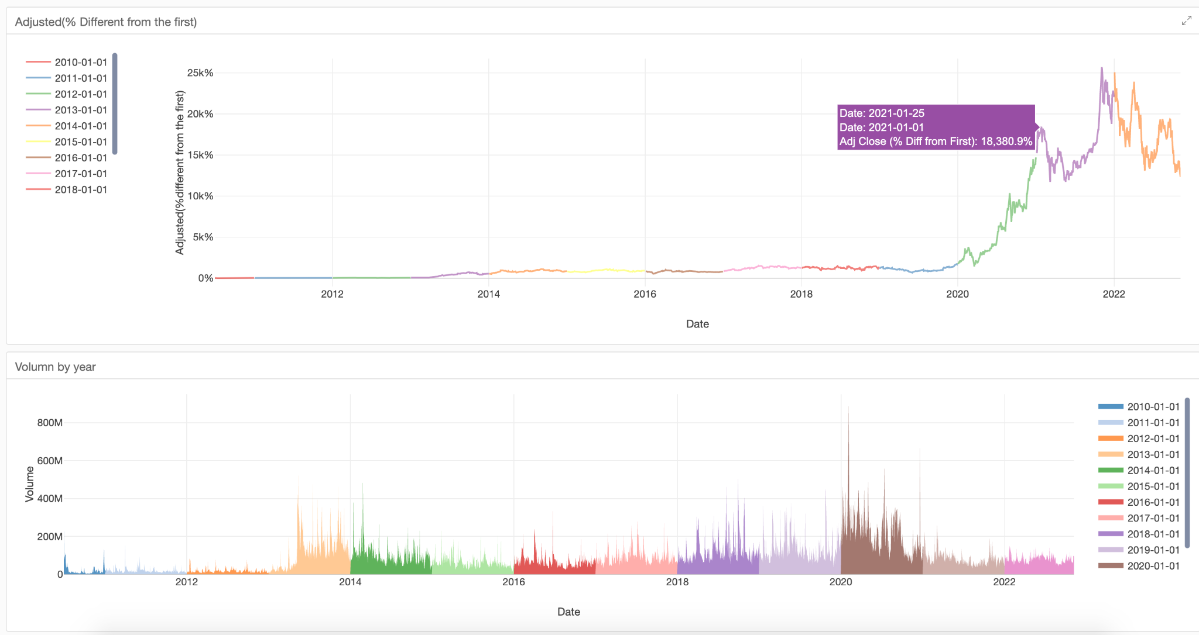
Stock Price Data Overview
Notes:
To see the movement of the stock price, we have plotted the relationship between the date and the percentage change in the adjusted closing price in the top chart. As you can see, the price did not change much until 2013. After 2013 the stock price started to rise and after 2020 the stock price rose significantly. The volume chart also shows that after 2013, more people started to follow the stock and trade it.

Slide 7
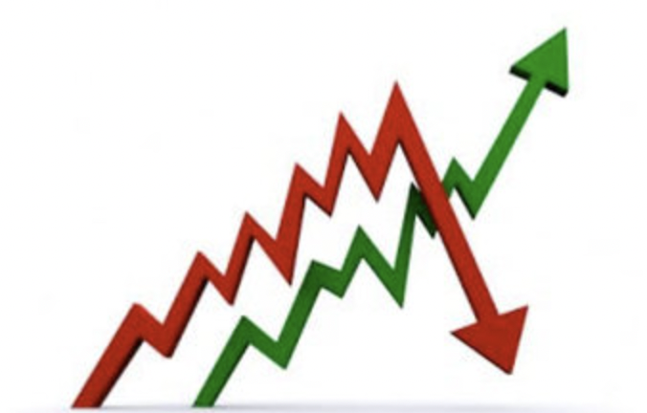
How to Define whether the Stock Price is increase, decrease or no change
Get medium price of the TESLA stock price
Medium Price = (High Price - Low Price) / 2
Compare the medium price with the Open price
Medium Price > Open Price -> “Increase”
Medium Price < Open Price -> “Decrease”
Medium Price = Open Price -> “No Change”
Notes:
We labeled our stock price change into three categories: increase, decrease, and no change. We first get the medium price in a day by taking the average between the high price and the low price. We defined the stock price change as an increase if the medium price is greater than the open price, and the decrease is defined if the medium price is less than the open price. If the open price equals the medium price, it will be labeled as no change.

Slide 8
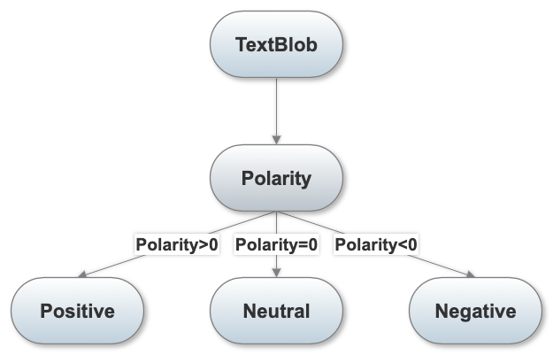
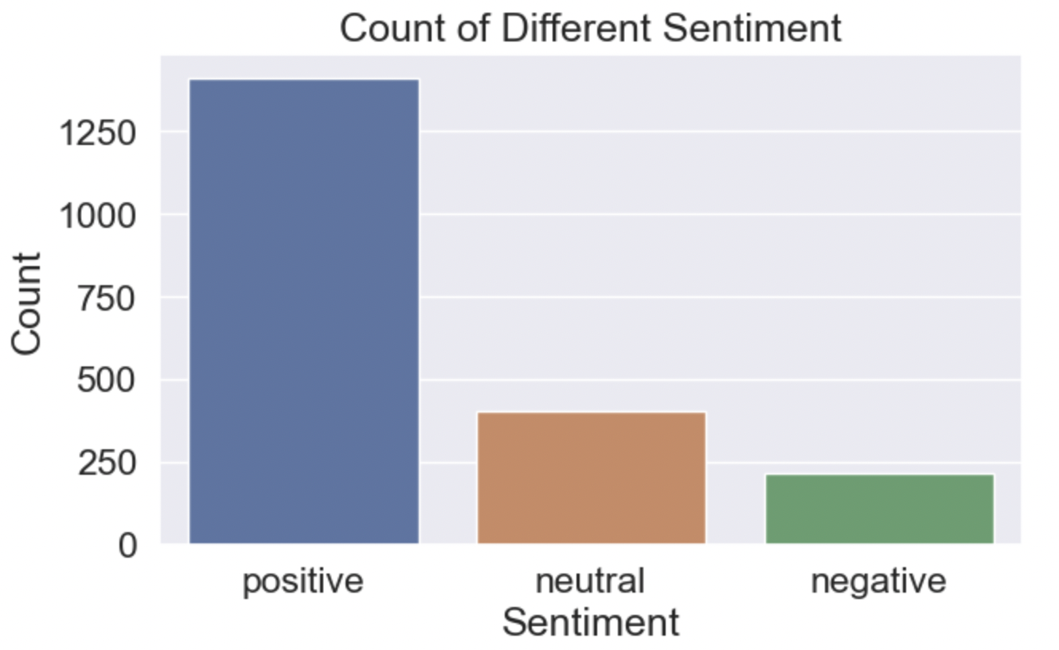
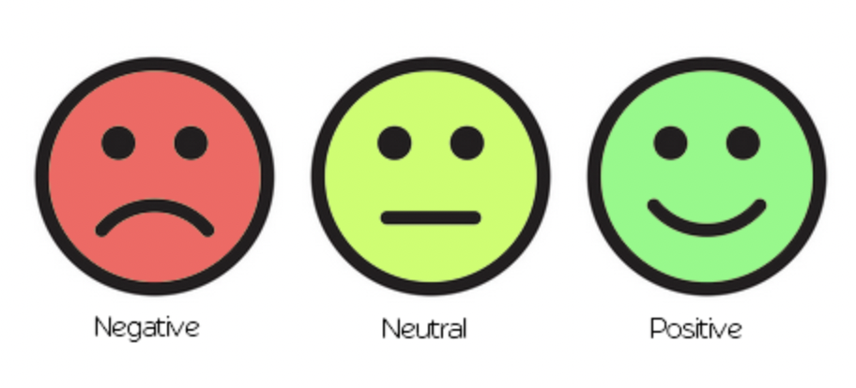
Sentiment Analysis
1%
Notes:
Textblob can be used for textual data analysis. When a sentence is passed into Textblob, it returns two outputs: polarity and subjectivity. Polarity lies between -1 and +1. A positive polarity indicates that the sentence has a positive sentiment, -1 refers to a negative sentiment, and 0 refers to the neutral. We labeled the tweets based on the polarity scores. From the count plot, we can see the majority of tweets have a positive sentiment. Only about 10% of them have a negative sentiment. From here we can find some shortcomings in our dataset, that is, the label is unbalanced.

Slide 9
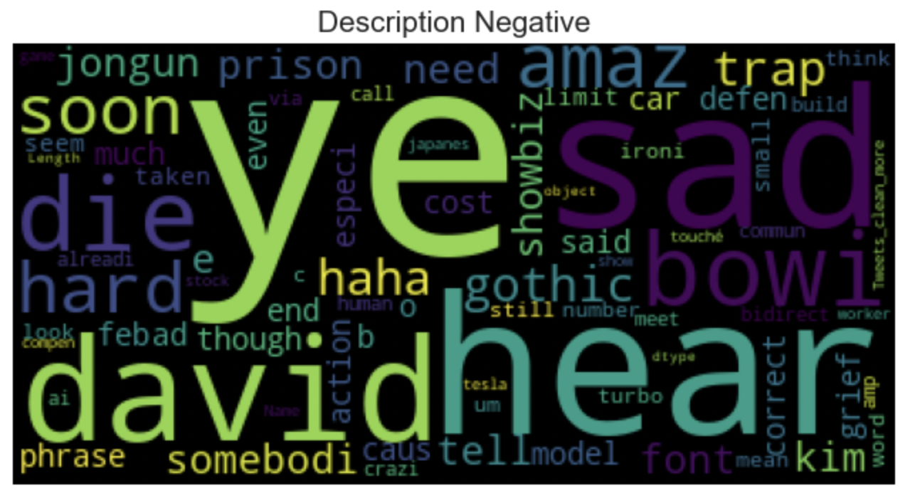
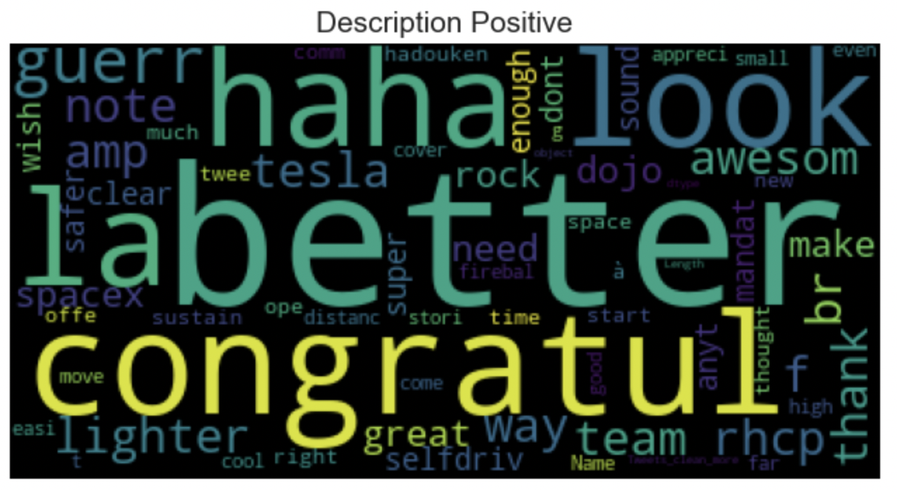
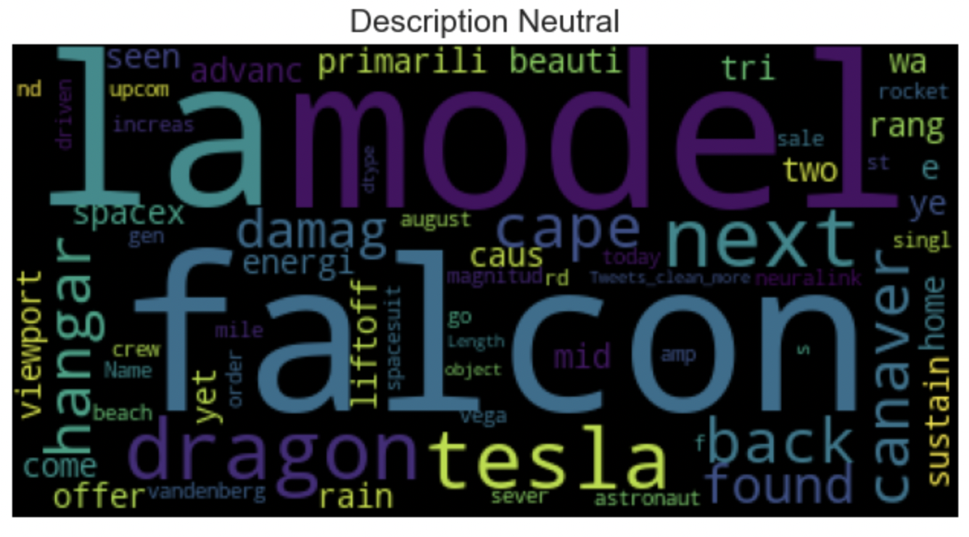
WordCloud
Notes:
Based on the emotion analysis, we drew word cloud diagrams for three different kinds of emotions. When the label is negative, the most frequent words are, 'sad', 'ye', and 'die'. When the label is positive, the most frequent words are, 'better', 'congratul', and 'haha'. When the label is neutral, the most frequent words are, 'model' and 'Tesla'.

Slide 10
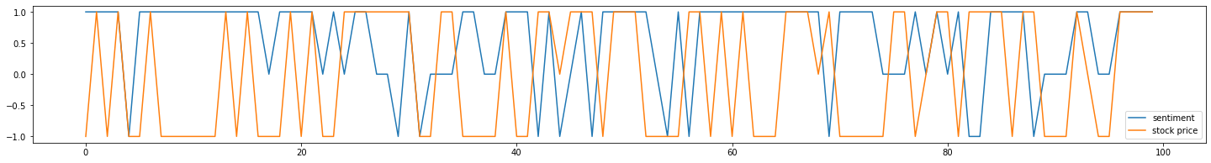
Granger Causality Test
Used to test whether one time series is useful for forecasting another.
In this project, Granger Causality test is used to test if tweet sentiment movement can be used for predict stock price movement.
The following is a plot of labeled sentiment and labeled stock price

Slide 11
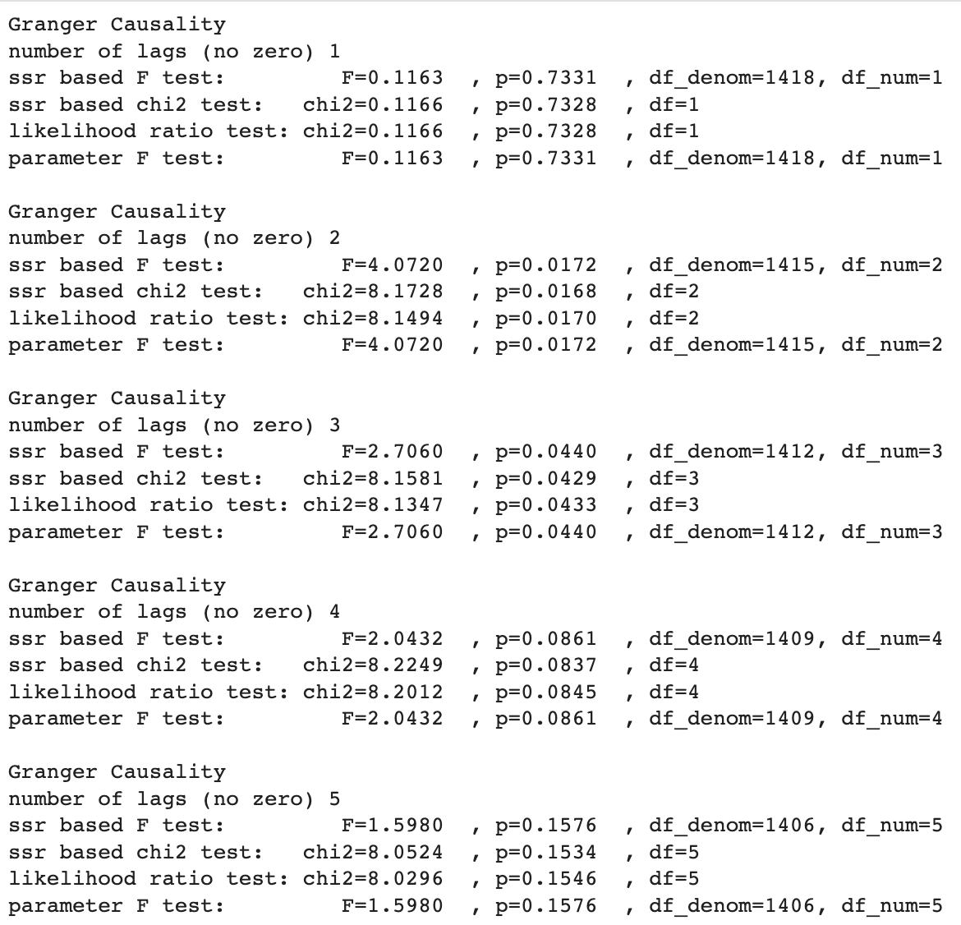
Granger Causality Test (cont.)
Granger causality test (test 1)
Null hypothesis: sentiment labels does not help for predict stock movement
Alternative hypothesis: sentiment labels granger-causes stock price labels change
The p-value is most significant with number of lags equals to 2.
Result: reject the null hypothesis, sentiment labels are helpful for predicting stock price movement.
Notes:
Now that we have labeled data for both stock prices and tweets. We would like to see if there is some relationship between them, which will be helpful for future analysis. So, we first matched the stock price change and sentiment of twitter day by day. And we did the granger causality test, which is used to test whether one-time series is helpful to predict another. The test result showed that at lag = 2 the model is the most significant with a p-value of 0.02, which indicates that first, the sentiment of musk’s tweets is helpful to predict the increase and decrease of stocks. And the effect of tweets will show up after 2 days.

Slide 12
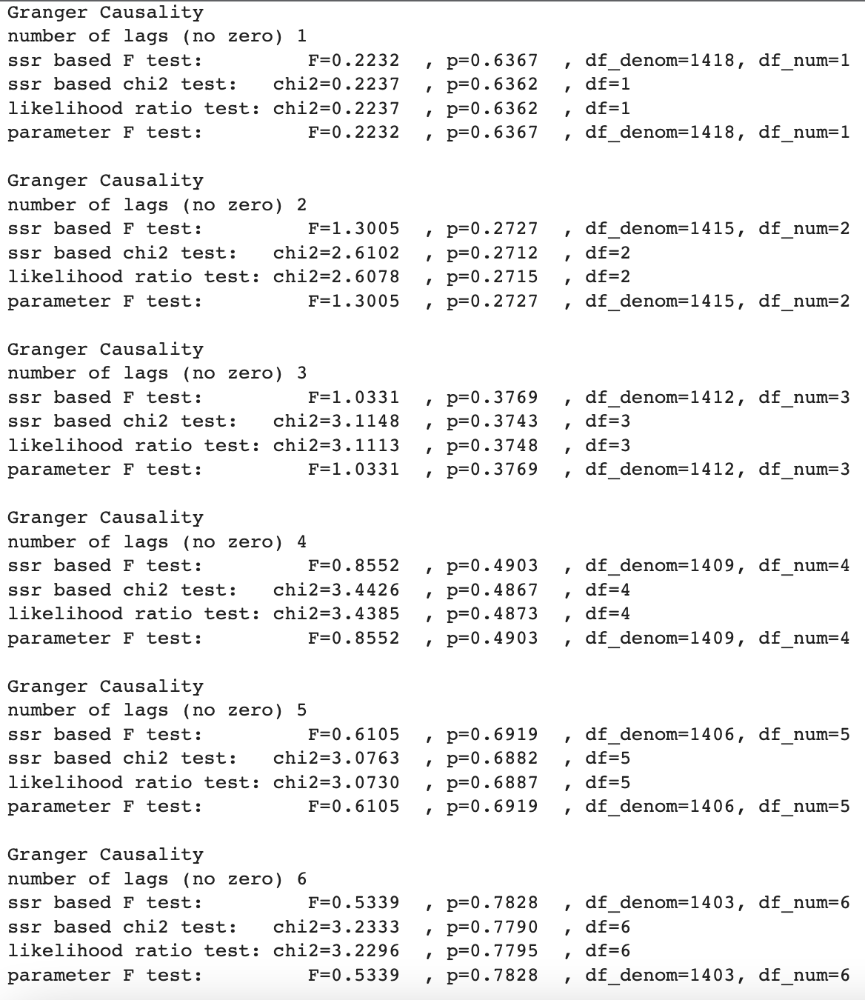
Granger Causality Test (cont.)
Granger test in reverse (used to test if the stock price label can be used to predict sentiment).
Result: p-value is not significant in this test with all lags, stock price does not helpful for predict the sentiment changes.
Conclusions:
Only sentiment changes are useful for predicting future stock price labels.
The effect of tweets on stock price changes will show up in after 2 days.

Slide 13
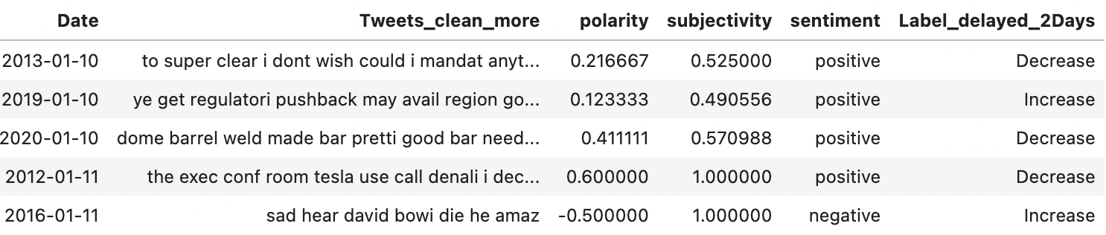
Combined two Datasets
To make the sentiment coherent to the stock label, the Label of stock price is used to pair the day before yesterday’s tweets
e.g: the tweet on 2011-12-05 is pairing with the TESLA stock price on 2011-12-07
The combined data frame has 1420 rows.
The data is from 2011-12-01 to 2021-04-16
Notes:
Based on that, we combined two datasets in another way to make the sentiment coherent with the stock label. We paired the label of the stock with tweets on the day before yesterday. That is to say, the tweet on Dec. 5 is paired with the stock change on Dec.7, and our final dataset has 1420 rows of records.

Slide 14
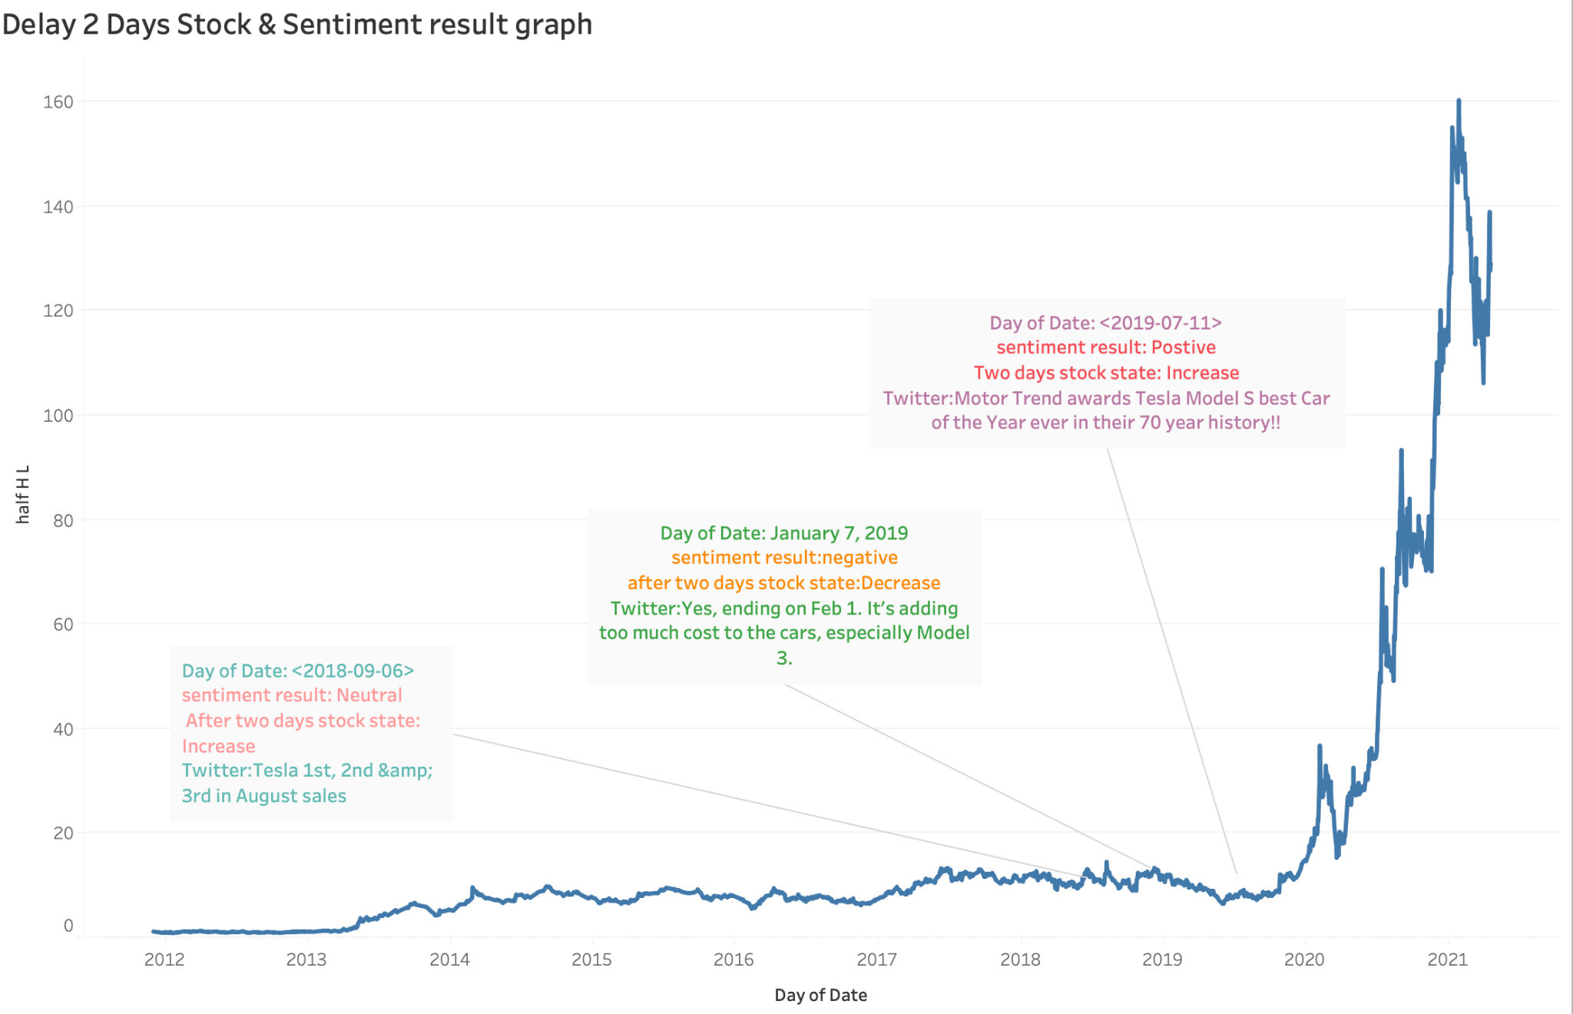
Sentiment Analysis with Stock Price
Notes:
Here is the combined stock price and sentiment plot, we highlighted some data points from it. We can see on July 11, 2019, the content of the tweet is about the Tesla model S was awarded as the best car, the sentiment of the tweet is positive, which may be one of the reasons why the stock price increased. Same as here on Jan.7, 2019, the content of the tweet is about adding cost to the cars, the sentiment of the tweet was negative, and the trend of the stock price is decreased. The tweet on Sep 6, 2019, is about tesla becoming the top seller, which is identified as neutral, but I think it is more likely a positive sentiment, and the stock price increased after that.

Slide 15
SVM & Naive Bayes
SVM
From sklearn.svm Python Package
Linear Kernel
Polynomial Kernel
Gaussian Radial Basis Function (RBF)*
Sigmoid Kernel
Naive Bayes
From sklearn.naive_bayes Python Package
Multinomial NB*
Gaussian NB
Bernoulli NB
Complement NB
* Highest accuracy
Notes:
Now we can start modeling. Since our data was labeled with the increase, decrease, and no change, we will use a classifier here. We tried a Support Vector Machine, with a linear kernel, RBF kernel, polynomial kernel, and sigmoid kernel. And in the naïve bayes model, we tried multinomial naïve bayes, gaussian naïve bayes, Bernoulli naïve bayes and complement naïve bayes. The final model evaluation will be provided later.

Slide 16
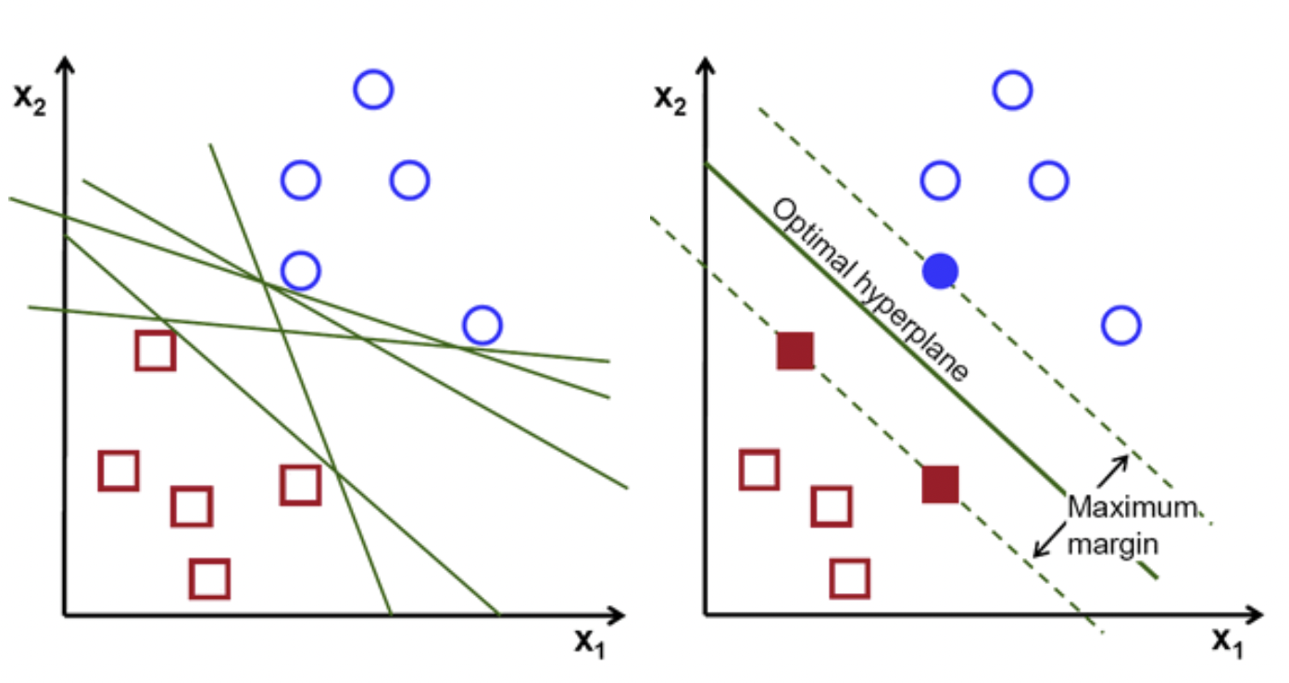
SVM Overview
The objective of the support vector machine algorithm is to find a hyperplane in an N-dimensional space(N — the number of features) that distinctly classifies the data points.
Notes:
Support vector machine (SVM) is a supervised machine learning algorithm mainly used for classification problems. In the SVM algorithm, each data item is plotted as a point in an n-dimensional space (where n represents multiple features), and the value of each feature is the value of a particular coordinate. Then, classification is performed by finding the hyperplane that distinguishes well between these two classes. Different kernel functions are available when the data is in a nonlinearly differentiable pattern.

Slide 17
SVM Pros & Cons.
Pros:
It works really well with a clear margin of separation.
It is effective in high-dimensional spaces.
It is effective in cases where the number of dimensions is greater than the number of samples.
It uses a subset of training points in the decision function (called support vectors), so it is also memory efficient.
Cons:
It doesn’t perform well when we have large data set because the required training time is higher.
It also doesn’t perform very well, when the data set has more noise i.e. target classes are overlapping.
SVM doesn’t directly provide probability estimates, these are calculated using an expensive five-fold cross-validation.

Slide 18
Different Kernels of SVM
Linear Kernel
This kernel is one-dimensional and is the most basic form of kernel in SVM.
Polynomial Kernel
This kernel is a general representation of kernels with a degree of more than one. It’s useful for image processing.
Gaussian Radial Basis Function(RBF)
RBF is the radial basis function. This is used when there is no (or very little) prior knowledge about the data.
Sigmoid Kernel
This is mainly used in neural networks.

Slide 19
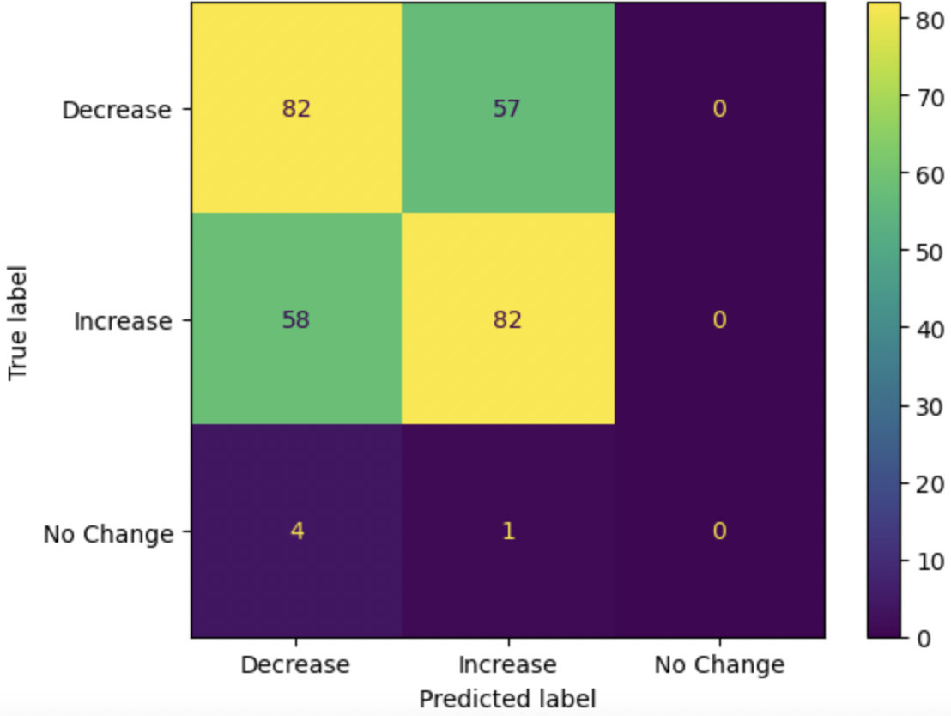
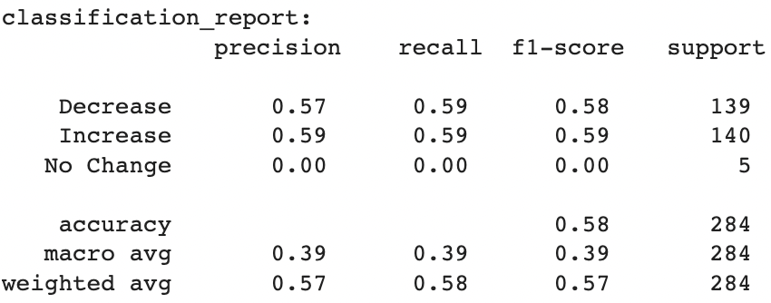
SVM RBF Kernel
—highest accuracy (57.7%) of all SVM models
“No Change” label is poorly predicted. This may due to less sufficient data to be trained in model.
Confusion Matrix of RBF Kernel
Notes:
After doing SVM with four different kernels, it was finally concluded that SVM with RBF kernel had the highest accuracy rate, 57.7%. According to the confusion matrix and classification report, our 'no change' label has a very poor accuracy. The reason may be that this label does not have enough accuracy to be trained. Therefore, we may enrich the data or merge it into other labels in the future.

Slide 20
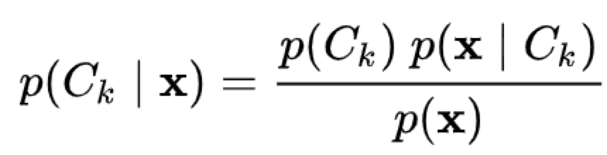
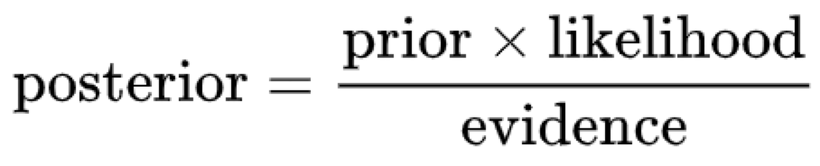
Naive Bayes Overview
Naive Bayes Classifiers are a family of simple “probabilistic classifiers” based on applying Bayes’ theorem with strong (naive) independence assumptions between features.
Conditional Probability expressed by Bayes Theorem
In Plain English
Assumption: The presence of a particular feature in a class is unrelated to the presence of any other feature.

Slide 21
Naive Bayes Pros. & Cons.
Pros:
It is easy and fast to predict class of test data set. It usually perform well in multi class prediction.
Because of assumption, a Naive Bayes classifier performs well with less training data.
It perform well in case of categorical variables compared to numerical variables, which is assumed as normal distribution.
Cons:
Zero Frequency: If categorical variable has a new category which was not observed in training data set, the model will assign a 0 probability and will be unable to make a prediction.
In real life, it is almost impossible to get a set of predictors which are completely independent.

Slide 22
Different Types of Naive Bayes
Gaussian Naive Bayes
GaussianNB implements the Gaussian Naive Bayes algorithm for classification. The likelihood of the features is assumed to be Gaussian.
Multinomial Naive Bayes
MultinomialNB implements the naive Bayes algorithm for multinomial distributed data, and is one of the two classic naive Bayes variants used in text classification.
Complement Naive Bayes
ComplementNB is an adaptation of the standard multinomial naive Bayes (MNB) algorithm that is particularly suited for imbalanced data sets.
Bernoulli Naive Bayes
BernoulliNB implements the naive Bayes training and classification algorithms for data that is distributed according to multivariate Bernoulli distributions; i.e., there may be multiple features but each one is assumed to be a binary-valued variable.

Slide 23
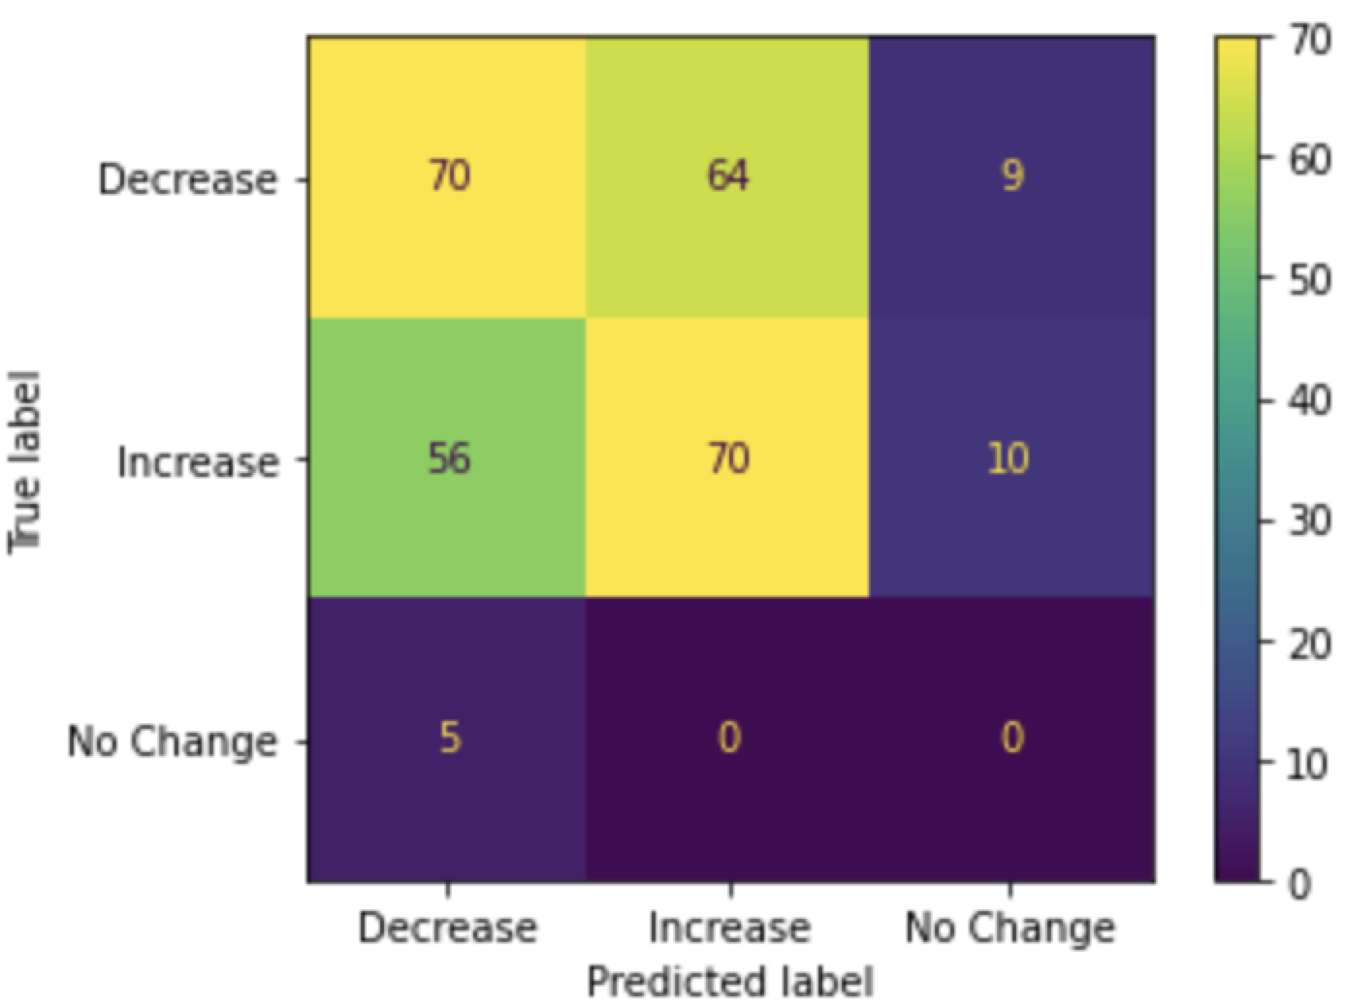
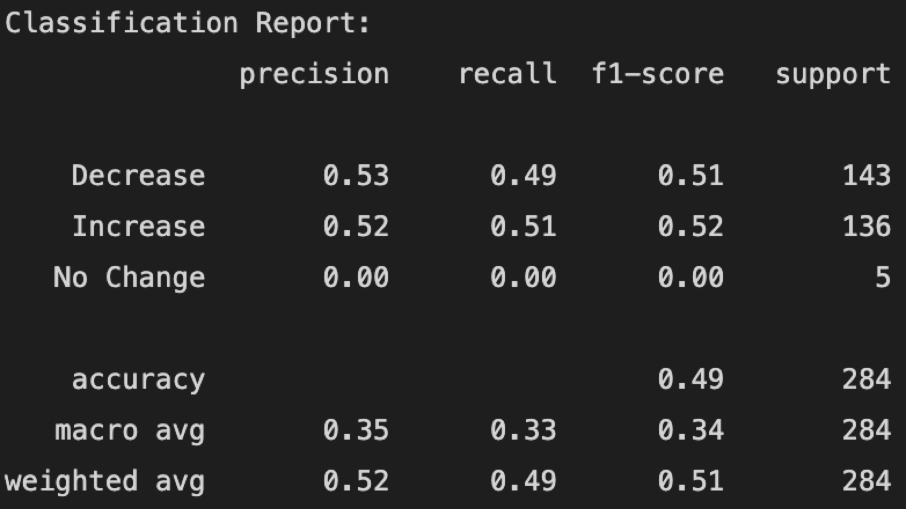
Multinomial Naive Bayes
—highest accuracy (49.3%) of all Naive Bayes models
“No Change” label is poorly predicted. This may due to less sufficient data to be trained in model.
Confusion Matrix of Multinomial Naive Bayes

Slide 24
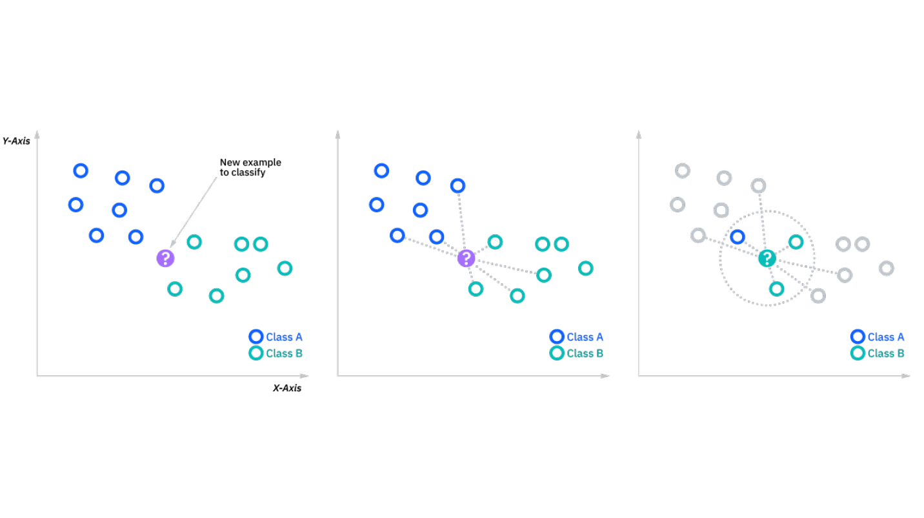
K-Nearest Neighbors Classifier
Model Introduction
A data classification method for estimating the likelihood that a data point will become a member of one group or another based on the distance.
Hyperparameter: n_neighbors & p (distance measurement)
Identifies the main idea of a document to implement text classification.
Picture from: https://www.ibm.com/topics/knn
Notes:
KNN classifier model is popular in some similar topic researches. It is a classifier which groups data based on the distance between the nearest n points. It can identify the main idea of documents based on the distance so it can be used for text classification. The main procedure is almost the same with previous models. We split the data, do the word tokenization. Fit the data into KNN model, fit the model multiple times with different hyperparameters and select the final model based on the accuracy score.

Slide 25
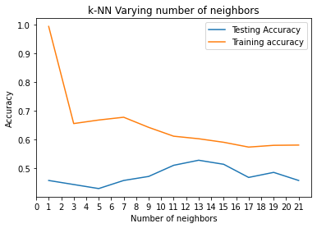
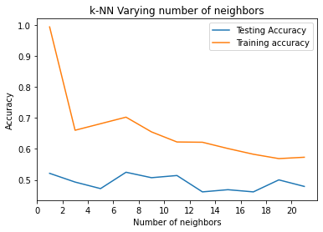
KNN - Hyperparameter Tuning
Model with manhattan distance
Model with Euclidean distance
The largest testing accuracy occurred at n=13 with p=1 and n=7 with p=2, and the final model will be defined based on the greatest accuracy

Slide 26
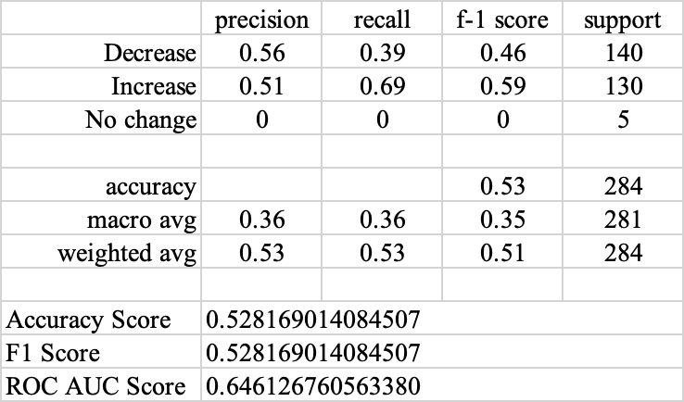
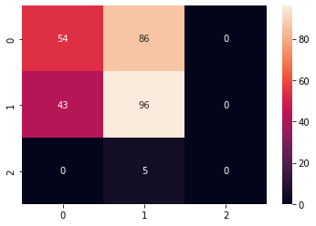
KNN - Model Evaluation
n_neighbors = 7 , p = 1
Classification Report: Confusion Matrix:
KNN model works good on classifying “Increase” tweets, but it does not work performance well on classifying “decrease” tweets

Slide 27
Random Forest Classification
sklearn.model_selection.RandomizedSearchCV was applied to find the best parameters
Possible parameters considered for finding the best model:
n_estimators = [5,20,50,100,150,200]
max_features = ['auto', 'sqrt']
max_depth = [int(x) for x in np.linspace(10, 120, num = 12)]
min_samples_split = [2, 6, 10]
min_samples_leaf = [1, 3, 4]
bootstrap = [True, False]
Best model found by randomizedSearchCV:

Slide 28
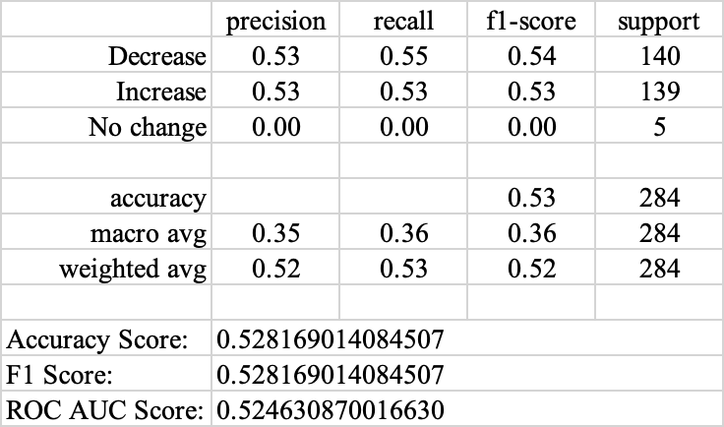
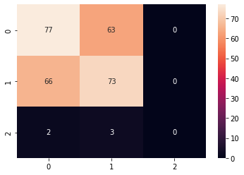
Random Forest Classification - Model Evaluation
This model performed relatively well on predicting increase and decrease movement, since we do not have to much data for neutral sentiment, it will be hard to predict on that.

Slide 29
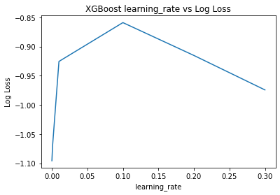
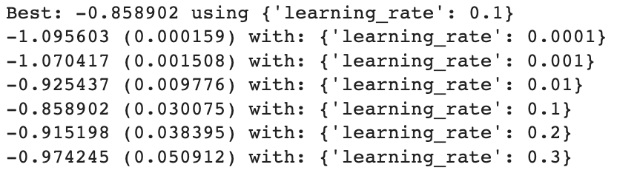
XGBoost for Classification
Also known as “Extreme Gradient Boosting”
Provides parallel tree boosting
Used for regression, classification and ranking problems.
Applied hyperparameter tuning for learning rate by using GridSearchCV
Setting the earning rate as 0.0001, 0.001, 0.01, 0.1, 0.2, and 0.3
Returns the best learning rate for data is 0.1.

Slide 30
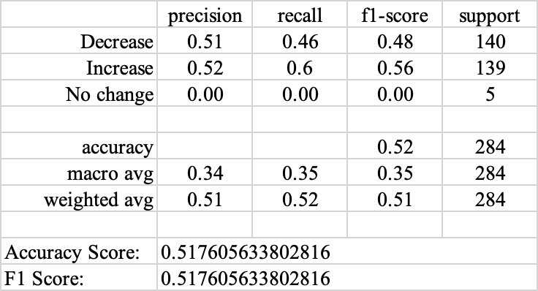
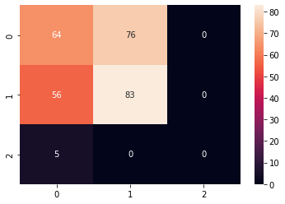
XGBoost - Model Evaluation

Slide 31

Bidirectional Encoder Representations from Transformers (BERT)
BERT is a deeply bidirectional, unsupervised language representation, pre-trained model using only a plain text corpus.
Unlike word2vec, BERT provides a contextualized embedding that will be different according to the sentence.
BERT uses attention mechanism to weigh the options to determine the meaning of a word in the sentence, based on the probability score.
Currently, BERT is being used at google search to optimize the interpretation os user search queries.

Slide 32
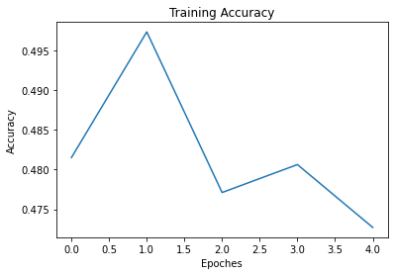
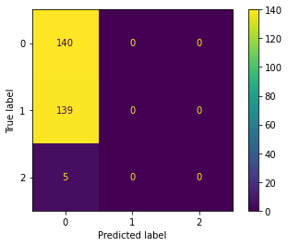
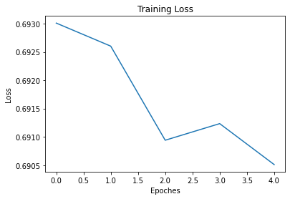
BERT - Model Evaluation
The bert model did not provide a better result.
There is problem with the model building process, so all the predictions were labeled as “0”.
Missing learning rate for the model.

Slide 33
Long Short-Term Memory Network
Definition: Long short-term memory(LSTM) is an artificial neural network used in fields of artificial intelligence and deep learning. LSTM has feedback connections, and is applicable to tasks such as unsegmented, connected handwriting recognition, machine translation, and robot control.
A common LSTM unit is composed of a cell, an input gate, an output gate and a forget gate. The cell remembers values over arbitrary time intervals and the three gates regulate the flow of information into and out of the cell.
Input Gate: It determines the extent of information be written onto the Internal Cell State.
Forget Gate: It determines to what extent to forget the previous data.
Output Gate: It determines what output(next Hidden State) to generate from the current Internal Cell State.

Slide 34
LSTM Network Advantages
LSTM solve the vanishing gradient problem in RNN.
The LSTM algorithm updates complexity per weight and time step is essentially that of BPTT, namely O(1).
Long time lags in certain problems are bridged using LSTMs where they also handle noise, distributed representations, and continuous values.
LSTM works well over a broad range of parameters, so parameter fine tuning does not need.
LSTM does not keep a finite number of states from beforehand as required in the hidden Markov Model.
Notes:
Back Propagation Through Time (BPTT): Backpropagation through time (BPTT) is a gradient-based technique for training certain types of recurrent neural networks. It can be used to train Elman networks. The algorithm was independently derived by numerous researchers.

Slide 35
LSTM Network Disadvantages
LSTM cannot remove vanishing gradients completely, because the data still has to move from cell to cell for its evaluation.
LSTM requires a lot of data and time to get trained, and needs high memory-bandwidth because of linear layers present in each cell which the system usually fails to provide for.
LSTM get affected by different random weight initialization and hence behave quite similar to that of a feed-forward neural network.
LSTM is prone to overfitting and is difficult to apply the dropout algorithm to curb this issue.
Notes:
Dropout is a regularization method where input and recurrent connections to LSTM units are probabilistically excluded from activation and weight updates while training a network.

Slide 36
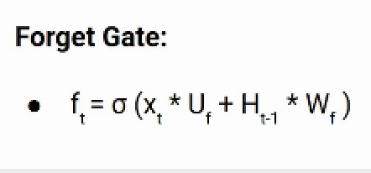
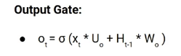
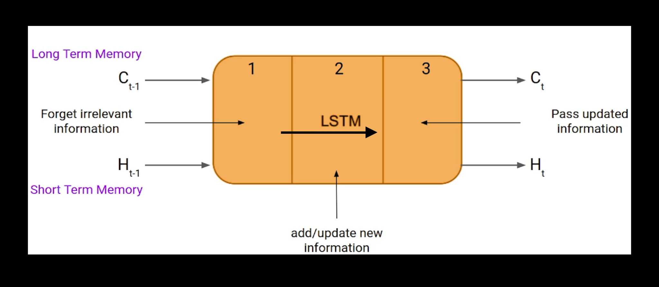
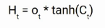
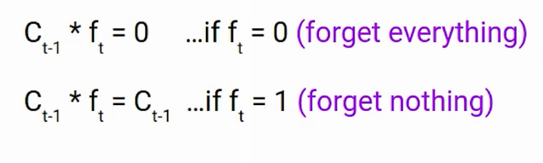
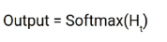
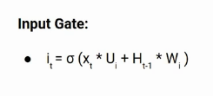
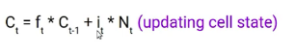
Long Short-Term Memory Network
Notes:
There three gate respectively, forget gate, input gate, and output gate.
First one is Forget Gate, this gate mainly decide what kind of information need to forget.
Input gate is used to quantify the importance of the new information carried by the input. Here is the equation of the input gate.
Output decide what information need to output based in previous sentence or previous state.

Slide 37

LSTM Example
Forget Gate
Input Gate
Output Gate
Sherry loves Sushi.
Victoria loves Ice cream.
Sherry loves Sushi.
She told me she had went all kind of restaurants to get tasty Sushi.
Victoria spent all her day dealing with homework and presentation, which makes her tired and _____?
Notes:
Let’s take an example to understand how LSTM works. Here we have two sentences separated by a full stop. The first sentence is “Sherry loves Sushi” and the second sentence is “Victoria loves ice cream. It is very clear, in the first sentence we are talking about sherry and as soon as we encounter the full stop(.) we started talking about Victoria.
So, in both these sentences, we are talking about Sherry. However, both give different kinds of information about Sherry. In the first sentence, we get the information that she loves Sushi. Whereas the second sentence tells she go to different restaurants to get Sushi.
During this task, we have to complete the second sentence. Now, the minute we see the word tired, we know that we are talking about a person. In the sentence only victoria is tried, we can not say the homework is tired or the presentation is tired. So based on the current expectation we have to give a relevant word to fill in the blank. That word is our output. That’s how LSTM model work, and we apply this model to our tweets data.

Slide 38
Process of LSTM
Step 5
Step 4
Step 3
Step 2
Step 1
Model Evaluation
Training and Cross Validation Data Split
Pre-Processing the Sequential Data
Word Embedding
Input Training Data
Notes:
Step 3 is very important
Since we will be analyzing short sentences and not long paragraphs of text we will choose the maximum number of tokens in the sentence to be 50.
If the tokens in a sentence are less than 50 we will be zero padding or trimming it so that all sequences are of the same length. This step makes sure training data consists of vectors of the same dimension.

Slide 39
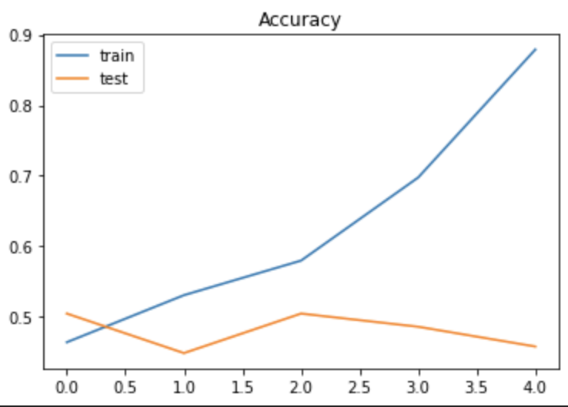
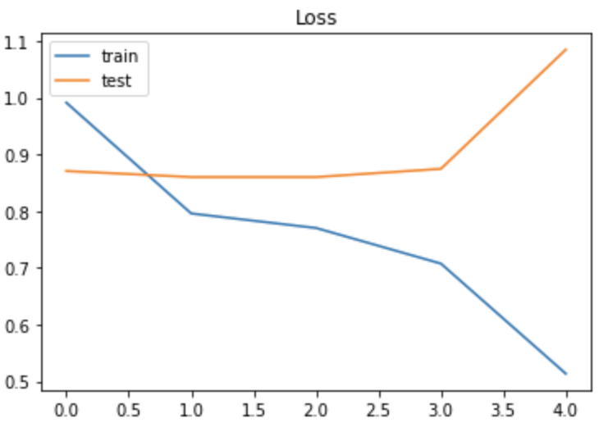
LSTM Result of Testing Dataset
The accuracy of our LSTM model(testing dataset) is 50.7%.
Show each epoch of Accuracy and Loss.
The prediction accuracy is highest at 2.0.
The Loss line of testing dataset is not good.

Slide 40
Models
Evaluation
 | KNN | SVM-Linear | SVM-RBF | SVM-Poly | SVM-Sigmod | MultinomialNB | GaussianNB | BernoulliNB | ComplementNB | Random Forest | LSTM
Accuracy | 0.528 | 0.556 | 0.577 | 0.528 | 0.507 | 0.493 | 0.458 | 0.461 | 0.356 | 0.524 | 0.507
F1 Score | 0.528 | 0.556 | 0.577 | 0.528 | 0.507 | 0.493 | 0.458 | 0.461 | 0.356 | 0.524
ROC Score | 0.525 | 0.667 | 0.683 | 0.646 | 0.630 | 0.620 | 0.593 | 0.596 | 0.517 | 0.522
Notes:
Here comes our model evaluation:
This table shows all model results we have already done, as you can see each model's accuracy, F-1 score, and Roc_score.
However, the highest prediction accuracy is not good enough. Even though we have done some hyperparameter tuning for our models.
In order to better improve the accuracy of our prediction model, we came to the ensemble model.

Slide 41
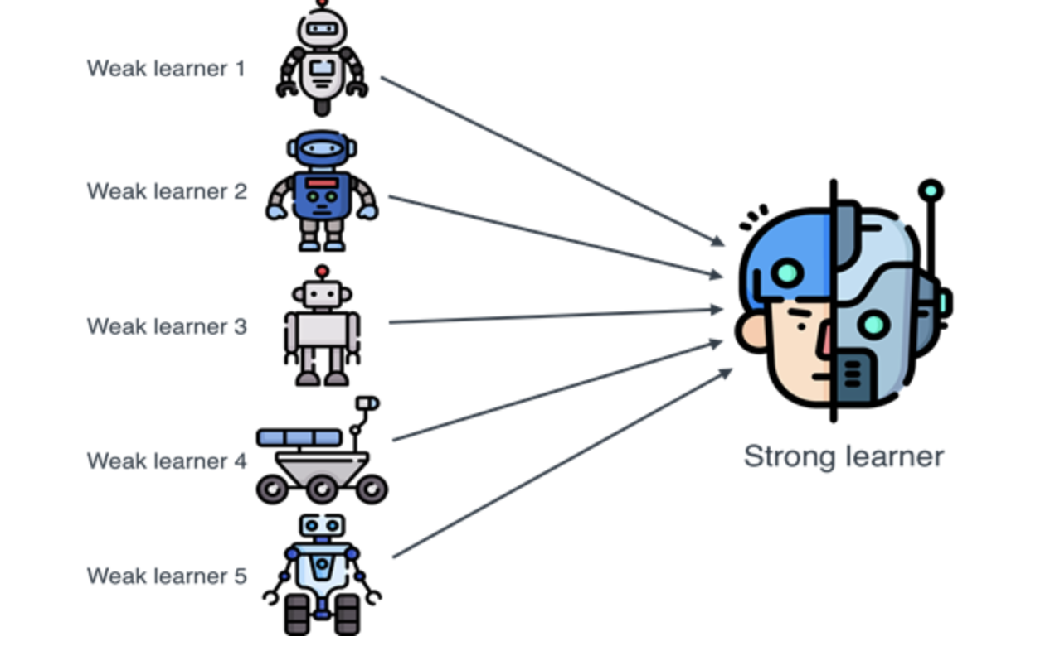
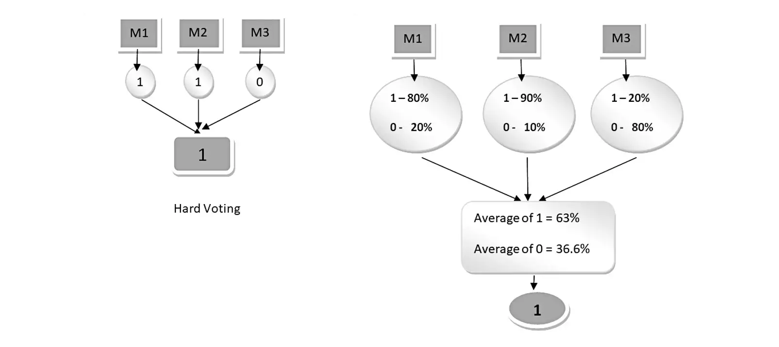
Voting Ensemble
A voting ensemble is an ensemble machine learning model that combines the predictions from the other multiple models.
To improve model performance, voting ensemble is chosen, because it ideally achieves better performance than any single model used in the ensemble.
Hard Voting: Predict the class with the largest sum of votes from models.
Soft Voting: Predict the class with the largest summed probability from models.
Notes:
There is a good example for us to understand the ensemble model.
So, as our learning model, we want to choose several basic models, and ensemble them into a strong and robust learner which is more powerful for our classification.
Ideally, we can get a model with better performance than any single model used in this ensemble.
Also, the voting ensembles have two ways to get their predicted result.
Hard voting’s result depends on the largest sum of votes, for example, in a binary classification, we have three basic models, class one gets two votes, and another class gets 1 vote. Then, the final predicted result is class one.
As for soft voting, each basic model needs to get a probability of each class, then make an average of all basic models. Finally, the ensemble model will get the probability of each class, the highest one is the predicted result.

Slide 42
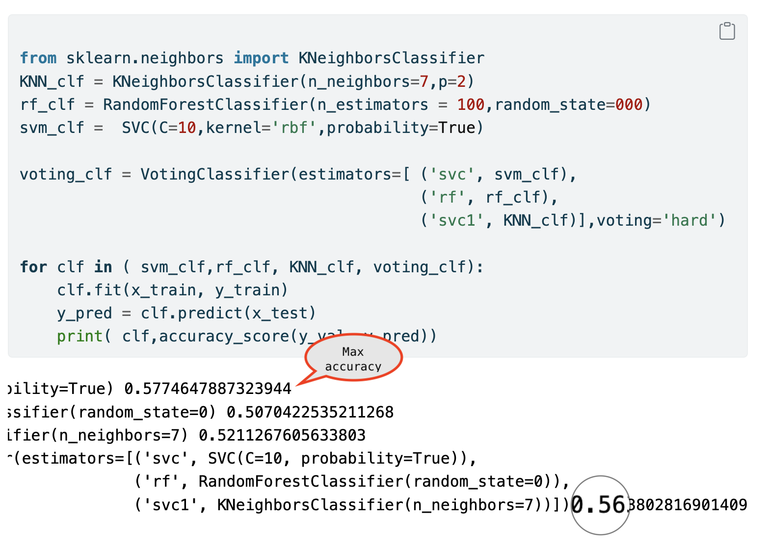
Ensemble Model Application & Result
Application:
Choose KNN, SVM-RBF, and Random Forest to make the ensemble model
Use “hard” voting method
Result:
The accuracy is 56%. Performance do not improve.
This ensemble model is not a ideally advanced model.
Notes:
“Hard” Voting means that each model has one vote.

Slide 43
Reasons for Non-Improvement in Ensemble Model
After Analyzing Shortcomes of Models…
We just directly added up three highest accuracy models and did not analyze the disadvantages of our models. Therefore, the shortcomes in each picked-up models did not solved by ensemble method.
To improve ensemble model, we should write the ensemble model by ourselves except using package. We should re-pick the model and adding weight to diffuse the weakness in each model.
Limitations
The label gotten from stock price is unbalanced. There are only 41 “No Change” labels. However, there are 692 “Decrease” labels and 687 “Increase” labels.
The label gotten from stock price is not completely correlated with Elon Musk’s tweets.
It is impossible to fully predict the Tesla stock price by Musk’s tweets. If it is possible, every one could be millionaires lol.
Notes:
We can analyze the shortcomes of each model. Then we can decide to choose which models are better put in ensemble model. We can also give weight to each model.

Slide 44
Conclusions
Data Cleaning
Connecting datasets
Training Model
Ensemble Model
Tweets Data
Subset Relevant variables
Remove hashtag, punctuation, …
Tokenization
Remove Stopword
Merge Tweets
Stock Data
Create labels to mark the trend of the stock
Sentiment analysis to the cleaned tweets
Granger Causality Test to determine the lag of date
Figure out the correlation between stock price’s label and sentiment analysis results
Combine two data sets
Use several methods to build the model
From Course
SVM
Naive Bayesian
Outside Course
LSTM
KNN
Random Forest
Find three models with the highest accuracy
SVM-RBF
Random Forest
KNN
Each model has one vote
Get accuracy of the ensemble model

Slide 45
Future Work
The accuracy is not really high.
Improve existing models (e.g: change the parameters in SVM, adding weights for ensemble model)
Build other advance model (e.g: other BERT, other ANN)
The Label is unbalanced.
“Decrease”: 692; “Increase”: 687; “No Change”: 41
Need more data; / Replace “No Change” by the other two labels
The result of sentiment analysis is not completely paired with the label of stock price.
Adding other variables to predict the trend of TESLA stock price
Notes:
Presentation Notes:
ANN ~ Artificial Neural Network

Slide 46
Q & A
Thank you

Slide 47
References - 1
Olteanu, Andrada. (2021). All Elon Musk's Tweets. Retrieved Nov 09, 2022, from https://www.kaggle.com/datasets/andradaolteanu/all-elon-musks-tweets?resource=download.
Tesla, Inc. (TSLA). Historical Data, Nov 09, 2022. Yahoo!Finance. https://finance.yahoo.com/quote/TSLA/history?period1=1277769600&period2=1667952000&interval=1d&filter=history&frequency=1d&includeAdjustedClose=true.
Mukhtar, N. (2020, May 29). Can we beat the stock market using Twitter? Medium. Retrieved December 4, 2022, from https://towardsdatascience.com/can-we-beat-the-stock-market-using-twitter-ef8465fd12e2
Nordin, J. (2020, April 16). Moods on twitter can predict stock price movements on NASDAQ - part 1. Medium. Retrieved December 4, 2022, from https://medium.com/@jang.noodin/moods-on-twitter-can-predict-stock-price-movements-on-nasdaq-part-1-9b128d4492ae
Gandhi, Rohith. “Support Vector Machine - Introduction to Machine Learning Algorithms.” Medium, Towards Data Science, 5 July 2018, https://towardsdatascience.com/support-vector-machine-introduction-to-machine-learning-algorithms-934a444fca47.

Slide 48
References - 2
Ray, Sunil. “6 Easy Steps to Learn Naive Bayes Algorithm with codes in Python and R” 29th November 2022
https://www.analyticsvidhya.com/blog/2017/09/naive-bayes-explained/#:~:text=In%20simple%20terms%2C%20a%20Naive,about%203%20inches%20in%20diameter.
Ray, Sunil. “SVM: Support Vector Machine Algorithm in Machine Learning.” Analytics Vidhya, 13 Sept. 2017, https://www.analyticsvidhya.com/blog/2017/09/understaing-support-vector-machine-example-code/.
“Long Short-term Memory.” Wikipedia, 8 Dec. 2022, en.wikipedia.
https://en.wikipedia.org/wiki/Long_short-term_memory
Understanding of LSTM Networks, 25 June, 2022
https://www.geeksforgeeks.org/understanding-of-lstm-networks/
Saxena, Shipra. “Introduction to Long Short Term Memory(LSTM)” 2nd Dec. 2022
https://www.analyticsvidhya.com/blog/2021/03/introduction-to-long-short-term-memory-lstm/
Long Short Term Memory Networks Explanation, 29 Sep. 2021
https://www.geeksforgeeks.org/long-short-term-memory-networks-explanation/
Lutkevich, B. (2020, January 27). What is Bert (language model) and how does it work? Enterprise AI. Retrieved December 8, 2022, from https://www.techtarget.com/searchenterpriseai/definition/BERT-language-model

